Slide 1

Understanding WACUHO Financial Policies and Budgets
PUTTING THE PIECES TOGETHER…

Slide 2
Jason M. Lu
Cal Poly Pomona
WACUHO Treasurer 2016 - 2018
59 University Dr.
Pomona, CA 91768
Office:(909) 869-3358
Fax: (909) 869-3985
treasurer@wacuho.org

Slide 3
WACUHO…
Is a non-profit 501(c)6 organization. Key word = non-profit
Is financially solid
Maintains policies and procedures to ensure financial strength and adherence to reasonable and customary business practices
Uses a low-risk investment strategy that helps support programs and scholarships

Slide 4
How does WACUHO make $$$?
Institutional Dues
Corporate Partner Dues
Investments
Surplus from zero based budgets and programs

Slide 5
What does WACUHO use its $$$ for?
General operating expenses
  Credit card expense
  Insurance and bond
  Supplies and Miscellaneous
  Hospitality and travel
  Printing and publications
Technology
Funding for non-fee generating committees
Scholarships and awards
Supporting programmatic committees that run a deficit

Slide 6
Program Committees
Fee generating
Zero-based budgets
Eligible for Association Reserve funding & Program Reserve funding
Examples: RAPs, Annual Conference, Western Training Institute, Pacific Management Institute
Some operating committees may also have a program element. Example: EDA one-day workshop

Slide 7
What is a zero-based budget?
Self supporting budget that is funded through program registration fees
  RAP’s
  Western Training Institute
  Annual Conference
  Pacific Management Institute
  One day conferences: DAA, Apart. & Comm. Living, etc.
Idea is to keep fees and expenses reasonable to cover costs but not make or lose $$$
If you do make $$$, surplus of funds goes to support various reserves

Slide 8
The budget proposal…
Revenues, CP, Reserve Allocations
Expenses
= Z E R O

Slide 9
Don’t wait until the last minute!
Before starting the process…
Refer to last years committee’s final budget and report for history, recommendations and a recent example
Talk to Exec Committee Liaison for any new directives for upcoming year
Ask the Treasurer for help – it’s okay!
Do your homework; get quotes for costs at host campus, vendors, etc.

Slide 10
Some tips on proposing revenues…
Registration Fees
Number of participants (Be conservative, look at trends)
“Comped” registrations? Section II, Professional Courtesies
Registration fees charged – LM, Sec. II Committee Responsibilities
Keep fees minimal to cover costs

Slide 11
Some tips on proposing revenues…
Where can I find additional funding?
Additional Funds for Committee Allocation – Ask the treasurer for details, funds must be proposed prior to Executive Committee Meeting
Association Reserve – One-time only funding. Exception for interpreting services. Available to all committees
Program Reserve – May be requested more than one time. Available to program committees only
Sponsorships: Corporate Relations Committee & outside donors

Slide 12
And some tips on expenses…
Food Service
Largest expense for “hosted” conferences
Keep close track of registration numbers and adjust order for increases or decreases
Be creative…can you find alternatives to reduce cost if needed?
Do you really need to feed people as often or as much as in the past?
If making changes, let participants know what to expect

Slide 13
And some tips on expenses…
Speaker/Facilitator
Sometimes only Honorarium is paid to cover all expenses
If expenses must be paid, are there “comped” rooms for lodging?
Someone special? Association or Program Reserves might be available
Don’t forget to include a “thank you” in gifts/awards

Slide 14
And some tips on expenses…
Personal Services Agreement
Any contracts for entertainment and special speakers must be in place before services are provided. If the provider does not have their own contract, complete a Personal Services Performed Agreement before requesting payment. Related expenses such as travel should also be included.
This is required even if you are paying your provider by an alternate means, such as a gift certificate

Slide 15
And some tips on expenses…
A / V can be very expensive. If allowed, bring in borrowed equipment from other institutions to reduce cost
Keep expenses associated with committee identifier (i.e. t-shirt, polo shirt, etc.) at a reasonable level
“Tasting” catering services:
  Annual Conference should budget for one sample meal
  Raps and WTI, as needed

Slide 16
And some tips on expenses…
Gifts
Volunteer “thank you” gift is allowed, but gifts for committee members are not permitted. Committee T-shirts are not considered a gift.
Committee dinner is an operational budget expense and should be coordinated by the Exec. Liaison. Check Leadership Manual under Programmatic Committee Receptions.

Slide 17
And some tips on expenses…
Printing/Advertising
Use the web page and email to save on printing and mailing expense
Badges, Lanyards, Name Tags
Participant lists
Other hand outs
Supplies
Raffles or giveaways
Large prizes such as Cameras, TVs, Game Consoles, are discouraged

Slide 18
And some tips on expenses…
Memorabilia: You may choose an additional item, but all participants must receive the Corporate Partners item from the previous WACE (2016 Cup)
Consider outside vendors and donors for giveaways
Contingency
Budget conservatively (i.e. revenue on the “low side”, expenses on the “high side”
For smaller programmatic budgets, shouldn’t need contingency

Slide 19
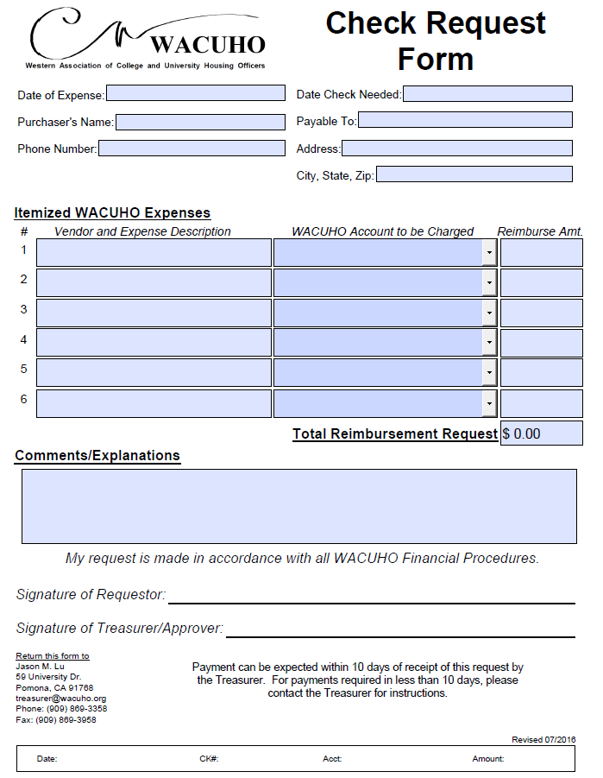
The all-important check request process…
Approval/Signatures: Requestor is the individual being reimbursed OR the person requesting payment for the vendor
Approver must be the Exec Liaison or Committee Chair
Original receipt only
Include itemized receipts
Checks written to individual members must have paid receipt
Check Request form must accompany request
For tracking purposes, detailed expense info is important. Separate check requests by expense type for clarity as needed.
Checks will be sent out quickly once proper documentation is received

Slide 20

Other important budget policies…
Checks:
  All Reg Forms should state: “WACUHO prefers check payments for [Program Name]; payment may also be made with a credit card through a secure payment portal.”
  Payable to WACUHO (verify before sending to Treasurer)
  Must be mailed to the Treasurer: 1) After receiving three or more checks, 2) Total deposit exceeds $3000, or 3) Once each week
  Send an electronic copy of check request to Treasurer prior to mailing checks
  Deposits over $4000 must be sent via registered mail
  DO NOT accept cash
  DO NOT send cash via mail
Credit Cards:
  May be accepted for all conferences via Reg-Online
  Transaction fees covered by WACUHO operating budget

Slide 21
Other budget tips…
Committee reception is covered by WACUHO operating budget (Section V, Financial Guidelines)
  $500 for Annual Conference
  $300 for all other programmatic committees. $20 per person if committee has fewer than 10 members.
Refund Policy (Section V, Financial Guidelines)
  Refunds provided at request if 30-days prior to conference
  Refunds requested 30 days or less before the program is complete will be held until the fiscal status of the program is determined, and will be honored at the discretion of WACUHO, minus a 10% processing fee
  Refunds will not be granted for “no shows”
  Refund made by check
All forms are available in the Leadership Manual (Financial Guidelines section) and online at www.wacuho.org/wiki

Slide 22
And now for the obligatory “no-no” list…
Travel or housing for committee members not permitted as budget expense
Gifts for committee members not permitted as budget expense
Food or snacks at meetings not permitted as budget expense
You cannot expense registration for host institution or committee members in the budget. Exceptions:
  Annual Conference chairs
  RAP committee members, as break-even budget allows
Association members cannot receive payment for making presentation except when serving as keynote or major speaker
All agreements for payments over $5,000 must be signed by the Treasurer or President
Committees may not open separate checking accounts. All deposits made through Treasurer
Alcohol expense cannot exceed 5% of budget

Slide 23
Wrapping up the conference budget…
Fully reconciled budget due to Treasurer 30 days after conference
  Please include detailed transaction info if possible
Attendee roster reconciled to revenues
Tick-and-tie with Treasurer’s records
Donations Budget Form to be submitted with final budget
Copy of approved Reserve Allocations or Platinum/Gold Plan funds is helpful (Treasurer also has a copy)

Slide 24
RegOnline
Senior Tech Coordinator and the Treasurer work together to administer this program
Your registration chair sets up the program and sets all dates and parameters according to your instructions
Treasurer manages all refunds or credits
Tips and To Dos
Check all registrants to insure that those who say they are members are paid members. This information is updated weekly.
When making adjustments to registration or fees, do it ONLY in the registration section. If the fees need to be adjusted in some other way, ask the Treasurer to do it.
Whenever making an adjustment or posting a check payment, write a comment to explain what the change was

Slide 25
Late Fees in RegOnline:
Set up the correct dates from the beginning in the system so that it can begin charging the updated fee after the registration deadline
If for any reason you need to adjust a campus to add or delete the late fee, go into the registration section and select the registration fee which matches the correct status
Non-Member Fees in RegOnline :
Check all registrants to insure that those who say they are members are paid members. This information is updated weekly.
Always have your MAL contact campuses who register as members but are not members
Always adjust fees for non-members and send out a new invoice as soon as possible after they register (there is an email invoice function in RegOnline)
Make sure your committee members and chairs are paid members of WACUHO to avoid problems later

Slide 26

Questions?

Slide 27
Thanks to…
Staci Buchwald
for original content
Tim Trevan
for creating this presentation
Ramona Hernandez, Cindy Derrico, and James Smith
for updating this presentation

Slide 28
Thanks to…
YOU!!!
for the work you do to benefit
your colleagues and the Association

